Slide 1
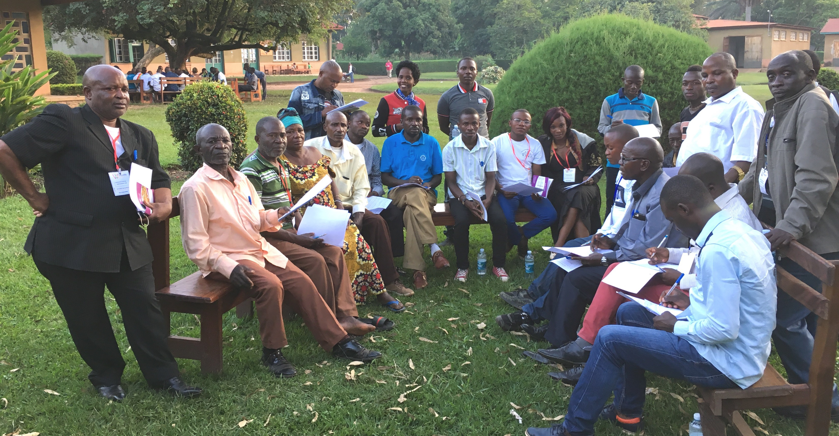
Church-Owned Bible Translation
6 Behaviors of the Local Church

Slide 2
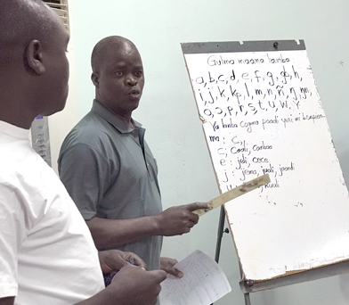

Translation
Responsible
Local Church
In Heart Language

Slide 3
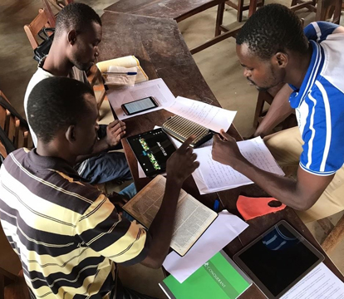

Accessibility
Accessibility
Local Church

Slide 4

Refinement and Revision
Checking
Refine
Translate
Revise
Church Team

Slide 5
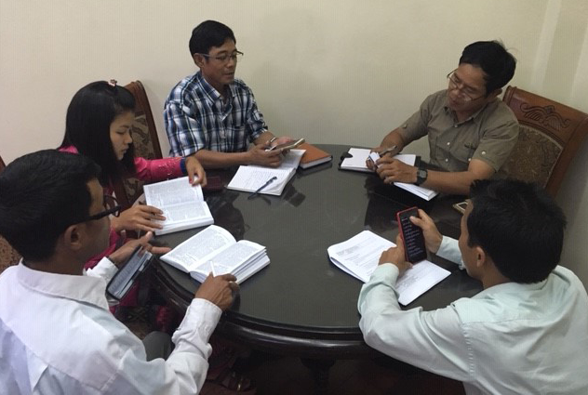
Scripture Engagement

Slide 6
Generational Ownership
Us
Our children
Our grandchildren

Slide 7
Shares COBT with others

Slide 8


